Slide 1

NUTRIBUDDY
DS5500 Capstone Project Presentation
Venkat Srinivasa Raghavan, Deepak Udayakumar, Aadarsh Gaikwad

Slide 2
NutriBuddy – Personalized Health Through AI
What is NutriBuddy?
- A personalized meal and exercise recommender system that uses AI and LLMs to suggest health-optimized plans based on user preferences, medical history, and real-time behavior.
Purpose of This Project
- Address the growing need for personalized nutrition and fitness solutions
- Tackle real-world ML challenges like cold-start, dynamic preferences, and user engagement
- Apply advanced AI techniques in a full-stack, real-time application
Why It Matters
- Helps individuals with dietary restrictions (e.g., diabetes, hypertension) make informed choices.
- Enhances user adoption through dynamic, relevant, and explainable recommendations.
- Demonstrates the practical power of LLM + recommender systems in healthcare AI

Slide 3

STUDENT OBJECTIVES: Learning Outcomes & Knowledge Application
Learning Outcomes:
Built a full-stack AI application using real-world health data
Learned how to design, evaluate, and optimize hybrid recommendation systems
Gained hands-on experience in integrating LLMs for medical data interpretation
Developed scalable, production-ready code using MLOps best practices
Application of Knowledge
Used Python, scikit-learn, FastAPI, Docker in a live recommendation workflow
Translated health-focused use cases into working AI-driven tools
Applied concepts from Machine Learning, NLP, and MLOps courses directly to our solution
3

Slide 4
STUDENT OBJECTIVES: Problem-Solving, Collaboration & Communication Skills
Critical Thinking & Problem-Solving
Tackled the cold-start problem using content-based filtering
Balanced personalization vs. diversity using weighted hybrid models
Designed a dynamic re-ranking strategy to adapt to real-time user feedback
Engineered solutions for handling unstructured medical inputs
Roles: Recommender System and MLOps (Venkat), NLP & LLM integration (Deepak),UI/UX (Aadarsh)
Coordinated development across backend, frontend, and modeling components
Practiced agile workflows and Git-based version control for smooth teamwork
Created intuitive user interfaces to present recommendations clearly
Used visual dashboards and clear slide content for stakeholder understanding
Documented project code and research on GitHub for reproducibility
Collaboration
Communication Skills
4

Slide 5
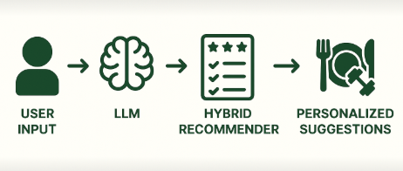
Problem Specification
Introduction to the Problem: Diet and fitness recommendation apps are commonly used, but they often fail to deliver personalized guidance based on a user’s medical history, goals, and dietary preferences. Most platforms use static suggestions and ignore how user needs evolve over time, resulting in low engagement and poor health outcomes.
Scope of the Problem: NutriBuddy aims to build an AI-driven meal and exercise recommender system that:
Considers user health conditions (e.g., diabetes, PCOS, hypertension)
Uses Large Language Models to understand medical details from free text
Applies a hybrid recommendation model (Content-Based + Collaborative Filtering)
Re-ranks results in real-time based on user feedback and engagement
5

Slide 6
PROBLEM SPECIFICATION (contd.)
Impact of the Problem
Users may receive generic recommendations that contradict their medical needs
Poor personalization leads to decision fatigue and low user trust
Lack of adaptation makes apps ineffective for long-term health goals NutriBuddy addresses these by offering responsive, relevant, and health-aligned suggestions, improving engagement and outcomes.
Main Challenges and Constraints
Other Challenges
Unstructured Medical Input Parsing free text like “I have thyroid + high BP
Cold Start problem
Recommending to new users with no prior data
Dynamic Preferences Adapting to changing tastes or health conditions
Real-Time Processing Ensuring quick updates with low latency
Recommendation Diversity Preventing repetition while staying relevant
Data Privacy
Managing sensitive health data responsibly
6

Slide 7
RELATED WORK
Paper | Their Method | NutriBuddy Improvement
Diet & Exercise System (Hafizha & Baizal) | Used K-Means + Random Forest | NutriBuddy adds user-based collaborative filtering & LLMs for adaptability
TF-IDF + Extra Trees (Boudaa et al.) | Focused solely on calorie optimization | NutriBuddy enhances this with LLM-based dietary constraint parsing
Diet Systems via ML (Nagati et al.) | No real-time feedback or conversational capability | NutriBuddy uses dynamic re-ranking + GPT-3.5 Turbo for personalization

Slide 8
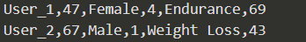
DATATSET DESCRIPTION
https://www.kaggle.com/datasets/venkyy123/fitness-recommender-dataset/data?select=recent_activity.csv
Diet Recommender System | Exercise Recommender System
Diet.csv – 512 meals with details on nutrients, diet types, and health conditions. | dataset.csv – 3,864 records detailing exercise performance, user demographics, calories burned, and workout intensity
user_Profiles.csv – 98 user records with dietary preferences, health conditions, and nutrient requirements. | Synthetic_User_Profiles_for_Exercise.csv – 100 user records with exercise preferences, health conditions, and fitness goals
recent_activity.csv – 983 user interactions with meals, tracking ratings, likes, searches, purchases, and timestamps. | Synthetic_Recent_Activity_for_Exercise.csv – 963 user interactions with exercises, tracking calories burned, duration, heart rate, and intensity.
8

Slide 9
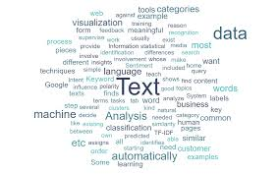
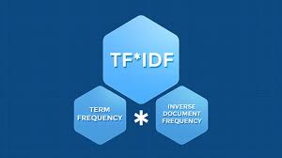
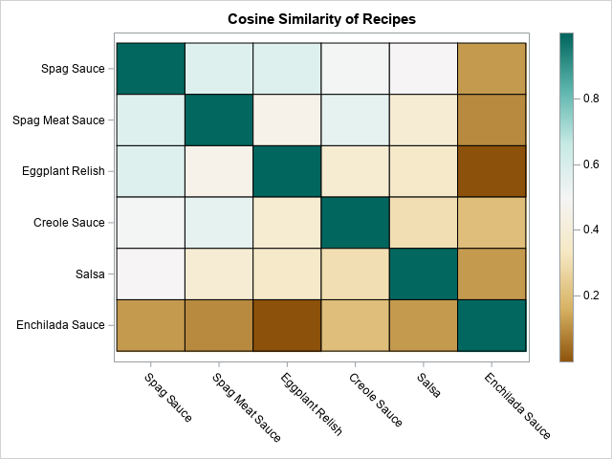

Data Preprocessing: Text-Based Similarity Calculation
1. Data Preparation
Standardized column names for consistency.
Combined key text fields (Name, Category, Description, Nutrient, Disease, Diet) into a single text feature for content-based filtering.
2. Feature Extraction Using TF-IDF
Applied TF-IDF Vectorization to convert text data into numerical form.
Used stop-word removal, bi-grams (1,2 n-grams), and set min_df=2 to reduce noise.
3. Similarity Computation with Cosine Similarity
Generated a TF-IDF matrix to represent textual features.
Computed Cosine Similarity to measure how similar two diet items are.
Helps recommend diets with similar nutrients, categories, and health benefits.
9

Slide 10
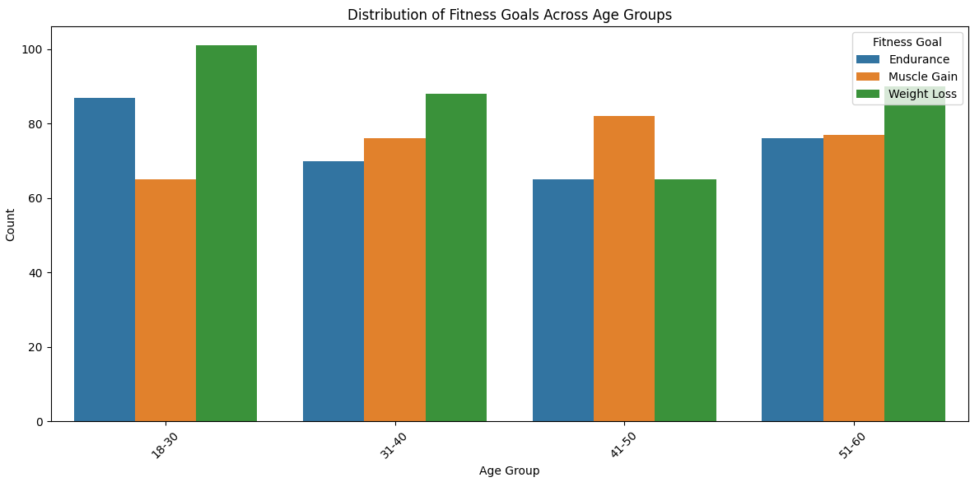
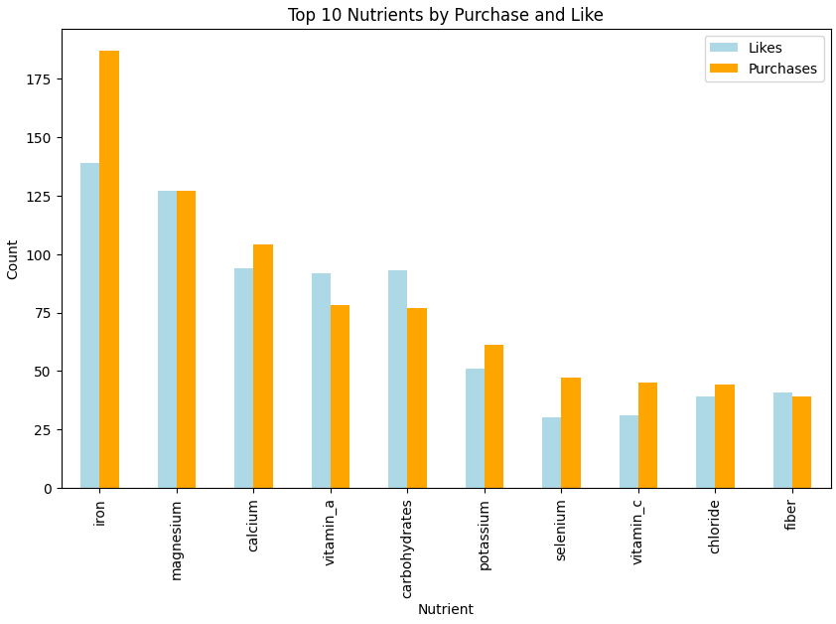
Exploratory Data Analysis
10
Fig: Top 10 Nutrients by Purchase and Like
Fig: Distribution of Fitness Goals Across Age groups

Slide 11
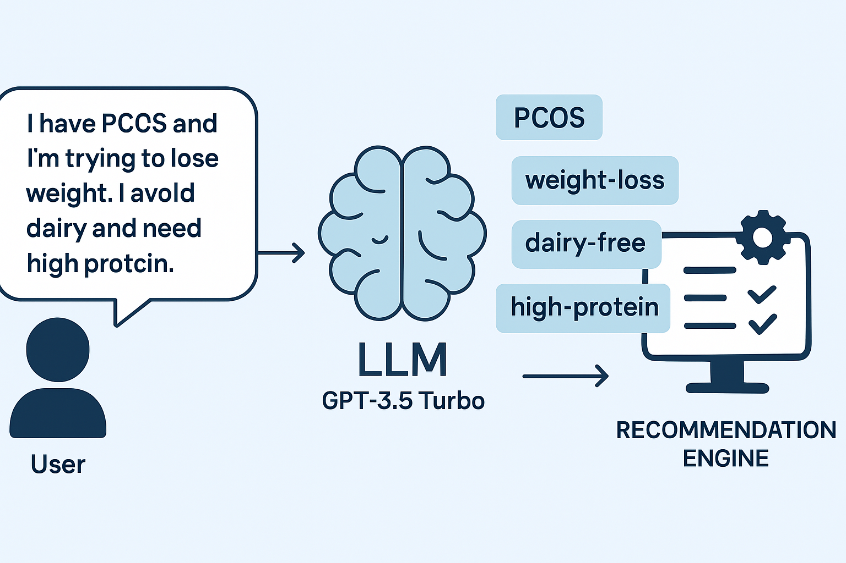
LLMs for Medical Understanding
Users provide free-text medical or dietary input (e.g., “I have diabetes and thyroid, and I avoid gluten”)
We send this input to OpenAI GPT-3.5 Turbo via API
LLM extracts structured tags like: ["diabetes", "low-sugar", "thyroid-safe", "gluten-free"]
Tags are fed into the Content-Based filtering pipeline to match meals with relevant health constraints
Enables us to support cold-start users and offer health-specific personalization
11

Slide 12
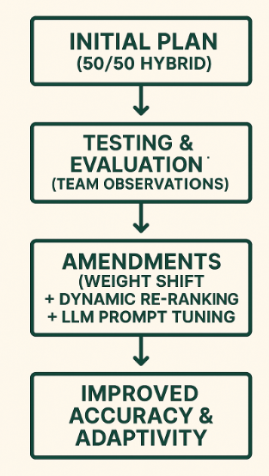
AMENDMENTS
Why We Made Changes
- 50/50 hybrid model didn’t generalize well in experiments
- Content-based filtering worked better for new users
- Needed more adaptability to reflect evolving user preferences
What We Changed
- Adjusted weights: 60% content-based / 40% collaborative
- Added dynamic re-ranking for real-time feedback
- Improved LLM prompt engineering for better dietary constraint parsing
Impact
- Precision@10 ↑ from 0.41 → 0.46
- Recall@10 ↑ from 0.86 → 0.91
- Improved cold-start performance and recommendation adaptability
12

Slide 13
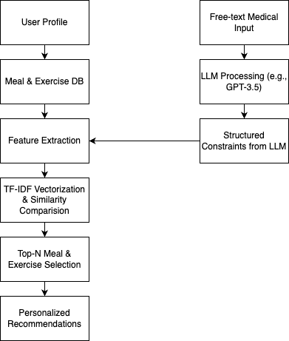
METHODOLOGY : CONTENT BASED FILTERING
STANDARD PIPELINE
LLM ENHANCEMENT
Uses TF-IDF to extract features from meal text data
Computes cosine similarity between meals and user profile
LLM processes medical inputs to extract dietary constraints
Structured tags from LLM are integrated into feature extraction
Enables personalized, health-aware recommendations even for new users
13

Slide 14
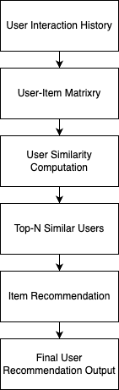
METHODOLOGY : COLLABORATIVE FILTERING
Builds a User–Item Matrix from past interactions.
Computes user similarity using cosine distance.
Identifies Top-N similar users.
Recommends meals liked by similar users
Works well when user history is rich

Slide 15
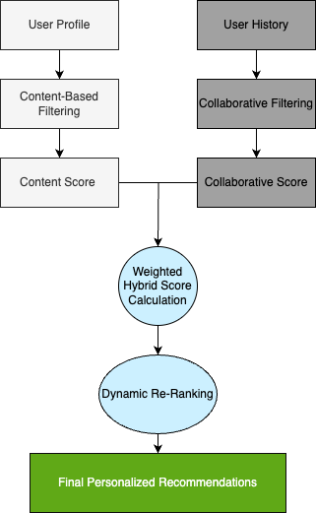
METHODOLOGY : HYBRID RECOMMENDATIOIN MODEL
Combines content-based and collaborative filtering outputs
Weights adjusted (60% content / 40% collaborative)
Dynamic re-ranking based on user engagement (likes/dislikes)
Delivers highly personalized and diverse suggestions
15

Slide 16
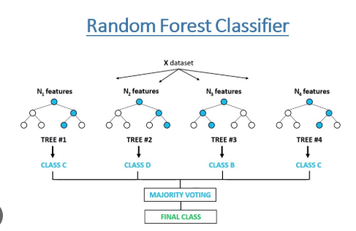
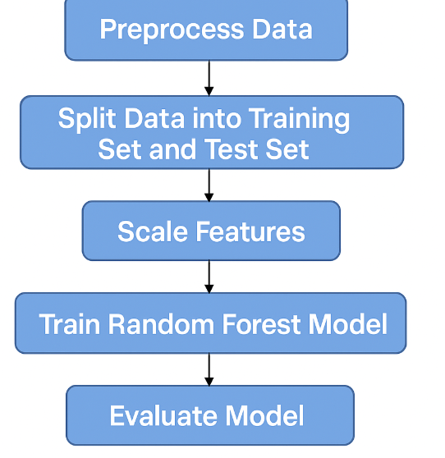
METHODOLOGY: EXERCISE RECOMMENDATIONS
Problem with Traditional Recommendation Models:
The standard recommendation models (Content-Based and Collaborative Filtering) performed poorly, as evident from low metrics like Precision@10 and Recall@10 in the evaluation results.
Shift to Classification:
Exercise recommendations were reframed as a classification task using BMI, age, gender, actual weight, and dream weight.
Justification:
This approach ensures that recommendations align with users' physical and health requirements rather than subjective preferences, leading to more effective and personalized suggestions.
16

Slide 17
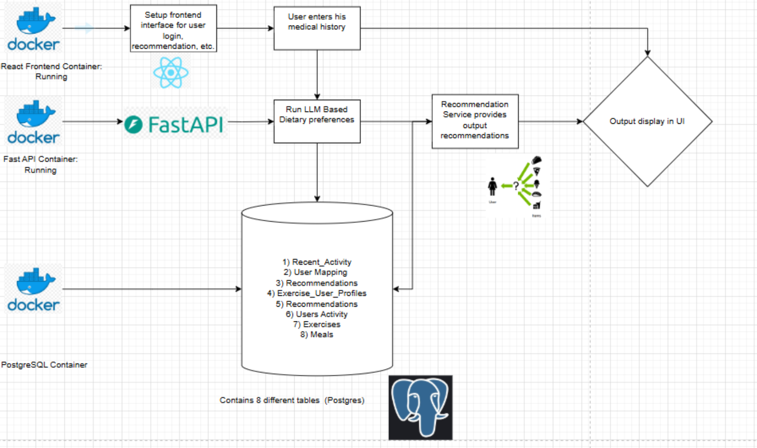

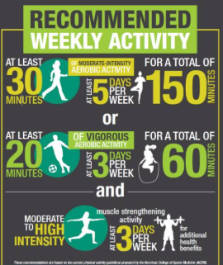
SYSTEM ARCHITECTURE
17

Slide 18
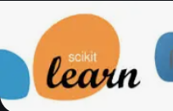







Toolkit & Technologies Used
Development & ML
Python – Core language for modeling & data processing
scikit-learn – ML models (KNN, SVD, hybrid methods)
Pandas, NumPy – Data manipulation & feature engineering
spaCy, NLTK – NLP preprocessing for dietary and medical text
LLM Integration
OpenAI GPT-3.5 Turbo API – Extract structured dietary constraints
Prompt Engineering – Tailored prompts for medical input parsing
Experimentation & Deployment
Jupyter Notebooks – Prototyping and analysis
Docker – Containerization for scalable deployment
FastAPI – Backend API for model interaction
PostgreSQL – Storing user history and meal metadata
Frontend & Visualization
React.js – Dynamic, responsive UI
Chart.js / matplotlib – Visualizing user trends and feedback
Collaboration & Version Control
Git & GitHub – Code collaboration and version tracking
18
18

Slide 19
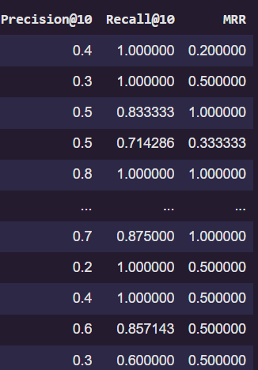
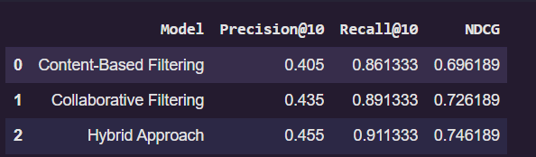
Evaluation Metrics (Diet Recommendations)
Individual User Metrics:
Precision@10 and Recall@10 vary across users, with Recall@10 often high (e.g., 1.0), indicating effective retrieval of relevant items.
MRR values reflect variability in ranking quality, ranging from 0.2 to 1.0.
Model Comparison:
The Hybrid Approach outperforms Content-Based and Collaborative Filtering models in all metrics: Precision@10: 0.455, Recall@10: 0.911333, NDCG: 0.746189
19
19

Slide 20
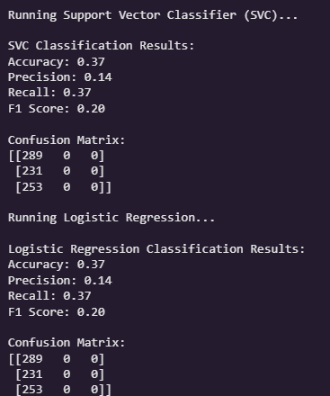
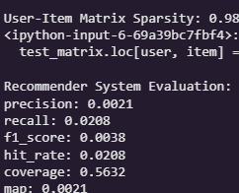
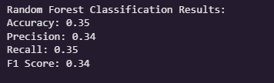
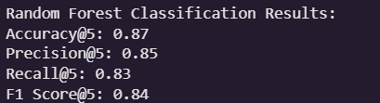
Evaluation Metrics (Exercise Recommendations)
Initial Model Evaluation:
Recommender system performance was significantly poor across all metrics.
Model Used: Random Forest Classifier was applied to predict exercise intensity levels.
Performance Metrics: Achieved an accuracy of 87%, with precision (0.85), recall (0.83), and F1 score (0.84) indicating room for improvement.
Class Distribution Challenge: Confusion matrix shows substantial misclassification across classes, especially between similar intensity levels.
20

Slide 21
TIME SCHEDULE
Jan 3rd - Mar 2nd Week → Scoping, Data Collection & Model Development
Defined objectives, system architecture, and datasets.
Processed data, built hybrid models for diet, integrated LLM.
Mar 3rd - Mar 4th Week→ Exercise Recommendation & Optimization
Develop exercise recommendation model.
Optimize performance & scalability.
Apr 1st → Final Testing & Deployment
Test & validate system, deploy recommendation engine & UI.
Submit final report & presentation.
Final Submission
Provide a fully functional nutribuddy application.
Adjustments for Delays:
Data issues? → Use synthetic data & feature engineering.
Model performance challenges? → Optimize hyperparameters & infrastructure.
Unforeseen delays? → Reallocate tasks & focus on critical components first.
21

Slide 22
POSTMORTEM
Learned how to integrate ML, LLMs, and MLOps into a full-stack, real-world system
Gained hands-on experience with recommendation models, including hybrid tuning and performance evaluation
Understood the importance of data quality, especially in preprocessing unstructured medical inputs
Faced challenges in LLM integration and real-time system performance, which improved our problem-solving skills
Learned to work effectively across roles (ML, NLP, frontend) using tools like Git, Docker, and FastAPI
22

Slide 23

Future Work
Create a full fleged android/ios application.
Improve recommendations using real time data rather than a dataset.
Build a large user base for the application to improve recommendations.

Slide 24
TEAM MEMBERS CONTRIBUTION
👤 Venkat Srinivasa Raghavan
Role: Machine Learning & Data Processing
Key Contributions: Built and fine-tuned collaborative + content-based models, developed scoring/ranking logic
Skills & Expertise: ML modeling, API design, data engineering, Dockerization
👤 Deepak Udayakumar
Role: LLM Integration & NLP Processing
Key Contributions: Integrated GPT-3.5 for medical history interpretation, handled unstructured data, optimized prompt workflows
Skills & Expertise: NLP, prompt engineering, LLM API integration, real-time inference optimization
👤 Aadarsh Gaikwad
Role: Frontend Development & UI/UX
Key Contributions: Built the React-based user interface, designed interactive recommendation flow, ensured smooth backend-frontend integration
Skills & Expertise: React.js, UI/UX, user-centric design
24

Slide 25

SAMPLE DEMO
25

Slide 26
REFERENCES
1. M. Ilham Hafizha and Z. K. A. Baizal, ”Diet and Physical Exercise Recommendation System Using a Combination of K-Means and Random Forest,” Ind. Journal on Computing, vol. 9, no. 2, pp. 83-96, Aug. 2024. doi:10.34818/indojc.2024.9.2.959.
2. B. M. Hassan and S. M. Elagamy, ”Personalized medical recommendation system with machine learning,” Neural Computing and Applications, Springer Nature, 2025. doi:10.1007/s00521-024-10916-6. 30
3. S. Nagati, J. Chaitanya, B. S. Rani, and R. Rohan, ”Diet Recommendation Systems Using Machine Learning Approaches, Challenges, and Future Directions,” International Research Journal of Education and Technology, vol. 6, no. 12, pp. 1872-1876, Dec. 2024.
4. B. Boudaa, A. Hammadi, and K. Akermi, ”A Diet Recommendation System Using TF-IDF and Extra Trees Algorithm,” International Journal of Electrical and Electronics Engineering and Informatics, vol. 12, no. 4, 2024. doi:10.52549/ijeei.v12i4.5809.
5. G. Qiao, D. Zhang, N. Zhang, X. Shen, X. Jiao, W. Lu, D. Fan, J. Zhao, H. Zhang, W. Chen, and J. Zhu, ”Food Recommendation Towards Personalized Wellbeing,” Trends in Food Science & Technology, vol. 156, Feb. 2025, 104877. doi:10.1016/j.tifs.2025.104877.
26

Slide 27
QUESTION AND ANSWER

